Slide 1
Object oriented Software development

Slide 2
Phases in Object-Oriented Software Development
In object-oriented software engineering, the software developer identifies and organizes the application in terms of object-oriented concepts, prior to their final representation in any specific programming language or software tools.
Any software development approach goes through the following stages:
Analysis,
Design, and
Implementation.

Slide 3
Object-Oriented Analysis
Object–Oriented Analysis (OOA) is the procedure of identifying software engineering requirements and developing software specifications in terms of a software system’s object model, which comprises of interacting objects.
The primary tasks in object-oriented analysis (OOA) are:
Identifying objects
Organizing the objects by creating object model diagram
Defining the internals of the objects, or variable
Defining the behavior of the objects, i.e., method
Describing how the objects interact

Slide 4
Object-Oriented Design
Object–Oriented Design (OOD) involves implementation of the conceptual model produced during object-oriented analysis. In OOD, concepts in the analysis model, which are technology−independent, are mapped onto implementing classes, constraints are identified and interfaces are designed, resulting in a model for the solution domain, i.e., a detailed description of how the system is to be built on concrete technologies.

Slide 5
The implementation details generally include:
Restructuring the class data (if necessary),
Implementation of methods, i.e., internal data structures and algorithms,
Implementation of control, and
Implementation of associations.

Slide 6
Object-oriented programming (OOP)
Object-oriented programming (OOP) is a programming paradigm based upon objects (having both data and methods) that aims to incorporate the advantages of modularity and reusability.
The important features of object–oriented programming are:
Bottom–up approach in program design
Programs organized around objects, grouped in classes
Focus on data with methods to operate upon object’s data
Interaction between objects through functions
Reusability of design through creation of new classes by adding features to existing classes

Slide 7
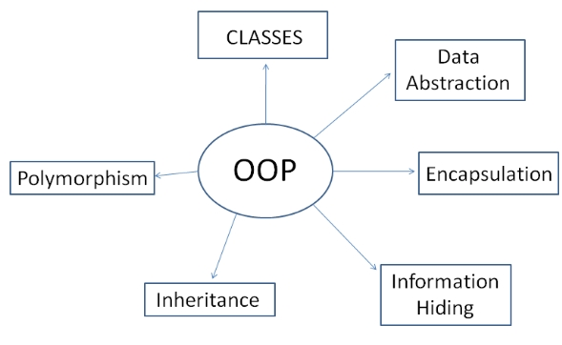
Main features/principles of OOP

Slide 8
Class and object
Object | Class
Object is an instance of a class. | Class is a blueprint or template from which objects are created.
Object is a real world entity such as pen, laptop, mobile, bed, keyboard, mouse, chair etc. | Class is a group of similar objects.
Object is a physical entity. | Class is a logical entity.
Object is created many times as per requirement. | Class is declared once.

Slide 9
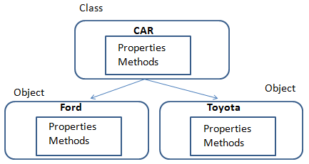
Example of class and object

Slide 10

Abstraction & Encapsulation
Encapsulation and abstraction is the advanced mechanism in C# that lets your program to hide unwanted code within a capsule and shows only essential features of an object. Encapsulation is used to hide its members from outside class or interface, whereas abstraction is used to show only essential features.

Slide 11

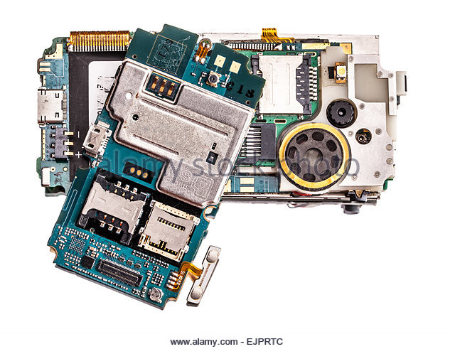
This is how it looks if we do not encapsulate

Slide 12
Inheritance
The process of obtaining the data members and methods from one class to another class is known as inheritance
Using inheritance, you can create a general class that defines common to a set of related items. This class can then be inherited by other classes, each adding those things that are unique to it.

Slide 13
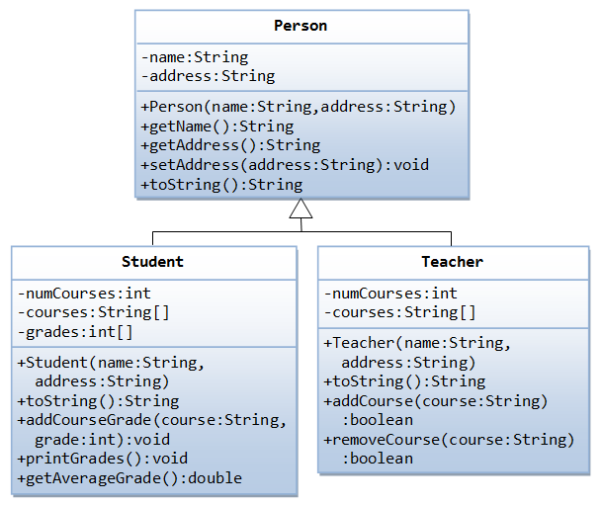
Inheritance example

Slide 14
Polymorphism
Polymorphism is occurrence an entity that has single name and many forms which acts differently in different situations or circumstances.
Polymorphism can only be achieved through the behaviors (methods)
It reduces our complexities.

Slide 15
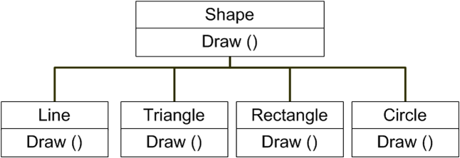
Polymorphism example

